Slide 1
PC BUILDER SYSTEM
Presented to
Safin Ahmmed Dipto
Lecturer
Department of Computer Science and Engineering
Khulna University of Engineering & Technology (KUET)
Course No : 1205
Course Title :
Object Oriented Programming

Slide 2
What is a PC Builder System?
A PC builder system, also known as a custom PC builder or a PC configurator, is an online tool or software that allows users to create and customize their own personal computer based on their specific needs and preferences.
SSD
GPU
CPU
HDD
RAM
PSU

Slide 3
About Our System
Allows users to choose components that match their performance requirements and budget
User Friendly
1
Compatibility Check
Provides compatibility check to ensure that the selected components are compatible with one another
2
Itemized List Of Products
Provides an itemized list of the chosen components along with their prices
3
Building A Custom PC
4
Helps to create a custom PC tailored to users’ specific computing needs

Slide 4
Code by Sumaiya Akter
#include <iostream>
#include <iomanip>
#include <string>
using namespace std;
int i, cpuInRep = 8, motherboardInRep = 4, ramInRep = 4, ssdInRep = 4;
double totalPrice;
int discount;
class CPU;
class Motherboard;
class RAM;
class SSD;
class PCConfig;
void title();
void homePage();
void checkoutPage();
void componentPage();
void cpuPage();
void motherboardPage();
void ramPage();
void ssdPage();
double calculateTotalCost(PCConfig);
double calculateDiscountedPrice();
class CPU {
public:
CPU() {}
CPU(string name, string socketType, int price)
: name(name), socketType(socketType), price(price) {}
string getName() { return name; }
string getSocketType() { return socketType; }
int getPrice() { return price; }
void showInfo() {
cout << "Model: " << name << "\n";
cout << "Socket Type: " << socketType << "\n";
cout << "Price: " << price << " BDT\n";
}
void unselect() {
name = "";
socketType = "";
price = 0;
}
private:
string name, socketType;
int price;
};
The necessary header files to include
Necessary classes to work with
*
CPU, Motherboard, RAM, SSD classes consist of basic specification of these components
Functions outside of class

Slide 5
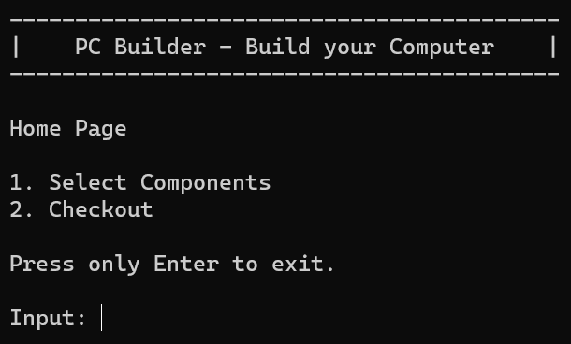
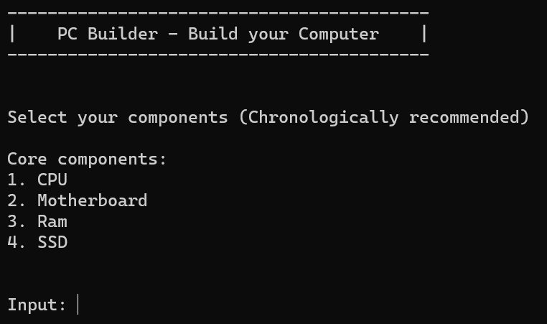
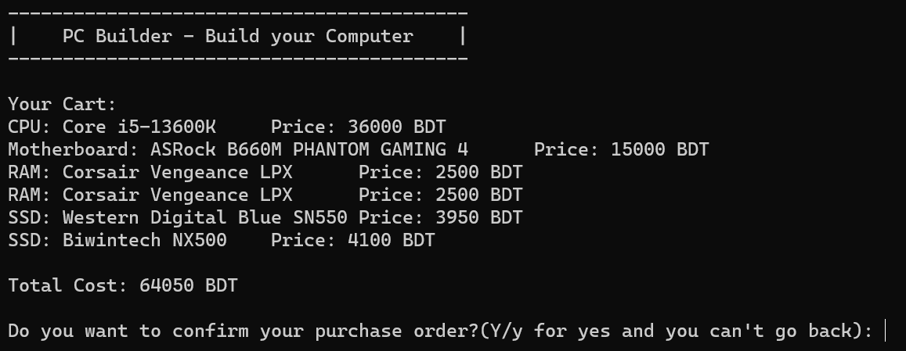
void homePage() {
int option, errorCheck;
string userInput;
title();
cout << "Home Page" << endl;
cout << "1. Select Components" << endl;
cout << "2. Checkout" << endl;
cout << "Press only Enter to exit." << endl;
cout << "Input: ";
fflush(stdin);
UserInputHome:
std::getline(std::cin, userInput);
if (userInput.empty()) {
exit(0);
}
else {
if (userInput.length() > 1) {
cout << "Invalid response! Input again: ";
goto UserInputHome;
}
else {
option = userInput[0];
switch (option) {
case '1':
componentPage();
break;
case '2':
checkoutPage();
break;
default:
cout << "Invalid response! Input again: ";
goto UserInputHome;
}
}
}
}

Slide 6
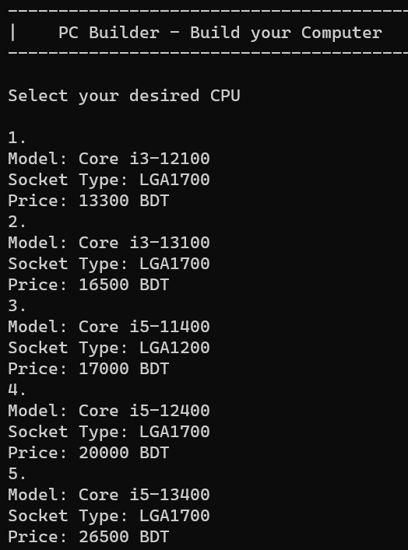

void cpuPage() {
int CPUIndex;
string userInput;
title();
cout << "Select your desired CPU" << endl;
cout << endl;
for (i = 0; i < cpuInRep; i++) {
cout << i + 1 << ".\n";
cpuRepository[i].showInfo();
}
cout << endl;
if (!(std::cin >> CPUIndex) || CPUIndex < 1 || CPUIndex > cpuInRep) {
cout << "Invalid response!" << endl;
}
else {
customerConfig.addCPU(cpuRepository[CPUIndex - 1]);
cout << "Press Enter to continue." << endl;
fflush(stdin);
std::getline(std::cin, userInput);
if (userInput.empty()) {
componentPage();
}
}
}
When the CPU user selected isn’t compatible with previously selected motherboard ↴

Slide 7
class PCConfig {
public:
void addCPU(CPU cpu) {
char yn;
if (motherboardIsSelected == false) {
selectedCPU = cpu;
CPUIsSelected = true;
cout << "CPU selected successfully." << endl;
}
else {
....................................................................................
}
bool getCPUIsSelected() { return CPUIsSelected; }
void addRAM(RAM ram, int quantity) {
for (i = 0; i < quantity; i++) {
selectedRAM[numRAMs] = ram;
numRAMs++;
}
}
int getNumRAMs() { return numRAMs; }
friend double calculateTotalCost(PCConfig);
private:
CPU selectedCPU;
bool CPUIsSelected = false;
Motherboard selectedMotherboard;
bool motherboardIsSelected = false;
RAM selectedRAM[100];
SSD selectedSSD[100];
int numRAMs = 0;
int numSSDs = 0;
};
void display() {
if (CPUIsSelected == true) {
cout << "CPU: " << selectedCPU.getName() << "\tPrice: " << selectedCPU.getPrice() << " BDT" << endl;
}
if (motherboardIsSelected == true) {
cout << "Motherboard: " << selectedMotherboard.getName() << "\tPrice: " << selectedMotherboard.getPrice() << " BDT" << endl;
}
if (numRAMs > 0) {
for (i = 0; i < numRAMs; ++i) {
cout << "RAM: " << selectedRAM[i].getName() << "\tPrice: " << selectedRAM[i].getPrice() << " BDT" << endl;
}
}
if (numSSDs > 0) {
for (i = 0; i < numSSDs; ++i) {
cout << "SSD: " << selectedSSD[i].getName() << "\tPrice: " << selectedSSD[i].getPrice() << " BDT" << endl;
}
}
}
This display() member function is used to display the components user selected when checking out

Slide 8
double calculateTotalCost(PCConfig config) {
double totalCost = 0.0;
totalCost = config.selectedCPU.getPrice() + config.selectedMotherboard.getPrice();
for (int i = 0; i < config.numRAMs; ++i) {
totalCost += config.selectedRAM[i].getPrice();
}
for (i = 0; i < config.numSSDs; ++i) {
totalCost += config.selectedSSD[i].getPrice();
}
return totalCost;
}
double calculateDiscountedPrice() {
double discountedPrice;
discountedPrice = totalPrice - totalPrice * discount / 100;
return discountedPrice;
}
void checkoutPage() {
char yn;
......................................................
......................................................
cout << "Do you have any coupon code(Y/y for yes): ";
std::cin >> yn;
if (yn == 'y' || yn == 'Y') {
enterCoupon:
cout << "Enter code: ";
std::cin >> coupon;
if (coupon == "Dc2005") {
discount = 5;
calculateDiscountedPrice();
goto purchaseComplete;
}
else if (coupon == "Dc2010") {
discount = 10;
calculateDiscountedPrice();
goto purchaseComplete;
}
else {
cout << "Invalid code! Want to try again?(Y/y for yes): ";
std::cin >> yn;
if (yn == 'y' || yn == 'Y') {
goto enterCoupon;
}
else {
cout << "Completing purchase without discount." << endl;
goto purchaseComplete;
}
}

Slide 9
Code by Enam E Elahi
#include <iostream>
#include <iomanip>
#include <string>
#include <fstream>
#include <sstream>
int i, cpuInRep, motherboardInRep, ramInRep, ssdInRep;
double totalPrice;
int discount;
class CPU;
class Motherboard;
class RAM;
class SSD;
class PCConfig;
void addCPUFromFile(std::string);
void addMotherboardFromFile(std::string);
void addRAMFromFile(std::string);
void addSSDFromFile(std::string);
void title();
void homePage();
void checkoutPage();
void componentPage();
void cpuPage();
void motherboardPage();
void ramPage();
void ssdPage();
double calculateTotalCost(PCConfig);
double calculateDiscountedPrice();
void generateLog(PCConfig);
class Motherboard {
public:
Motherboard() {}
Motherboard(std::string name, std::string socketType, int price)
: name(name), socketType(socketType), price(price) {}
std::string getName() { return name; }
std::string getSocketType() { return socketType; }
int getPrice() { return price; }
void showInfo() {
std::cout << "Model: " << name << "\n";
std::cout << "Socket Type: " << socketType << "\n";
std::cout << "Price: " << price << " BDT\n";
}
void unselect() {
name = "";
socketType = "";
price = 0;
}
friend void addMotherboardFromFile(std::string);
private:
std::string name, socketType;
int price;
};

Slide 10
class PCConfig {
public:
void addCPU(CPU cpu) {
char yn;
if (motherboardIsSelected == false) {
selectedCPU = cpu;
CPUIsSelected = true;
cout << "CPU selected successfully." << endl;
}
else {
....................................................................................
}
bool getCPUIsSelected() { return CPUIsSelected; }
void addRAM(RAM ram, int quantity) {
for (i = 0; i < quantity; i++) {
selectedRAM[numRAMs] = ram;
numRAMs++;
}
}
int getNumRAMs() { return numRAMs; }
friend double calculateTotalCost(PCConfig);
private:
CPU selectedCPU;
bool CPUIsSelected = false;
Motherboard selectedMotherboard;
bool motherboardIsSelected = false;
RAM selectedRAM[100];
SSD selectedSSD[100];
int numRAMs = 0;
int numSSDs = 0;
};
void display() {
if (CPUIsSelected == true) {
cout << "CPU: " << selectedCPU.getName() << "\tPrice: " << selectedCPU.getPrice() << " BDT" << endl;
}
if (motherboardIsSelected == true) {
cout << "Motherboard: " << selectedMotherboard.getName() << "\tPrice: " << selectedMotherboard.getPrice() << " BDT" << endl;
}
if (numRAMs > 0) {
for (i = 0; i < numRAMs; ++i) {
cout << "RAM: " << selectedRAM[i].getName() << "\tPrice: " << selectedRAM[i].getPrice() << " BDT" << endl;
}
}
if (numSSDs > 0) {
for (i = 0; i < numSSDs; ++i) {
cout << "SSD: " << selectedSSD[i].getName() << "\tPrice: " << selectedSSD[i].getPrice() << " BDT" << endl;
}
}
}
This display() member function is used to display the components user selected when checking out

Slide 11
void homePage() {
int option, errorCheck;
string userInput;
title();
cout << "Home Page" << endl;
cout << "1. Select Components" << endl;
cout << "2. Checkout" << endl;
cout << "Press only Enter to exit." << endl;
cout << "Input: ";
fflush(stdin);
UserInputHome:
std::getline(std::cin, userInput);
if (userInput.empty()) {
exit(0);
}
else {
if (userInput.length() > 1) {
cout << "Invalid response! Input again: ";
goto UserInputHome;
}
else {
option = userInput[0];
switch (option) {
case '1':
componentPage();
break;
case '2':
checkoutPage();
break;
default:
cout << "Invalid response! Input again: ";
goto UserInputHome;
}
}
}
}

Slide 12
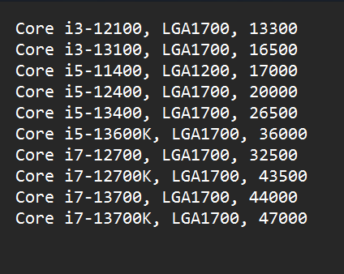
void addCPUFromFile(std::string fileName) {
std::ifstream file(fileName);
if (!file) {
std::cerr << "Error opening file: " << fileName << std::endl;
}
else {
cpuInRep = 0;
std::string line;
while (std::getline(file, line)) {
std::stringstream ss;
ss << line;
std::string name, socketType;
int price;
char delimiter = ',';
std::getline(ss, name, delimiter);
std::getline(ss, socketType, delimiter);
ss >> price;
cpuRepository[cpuInRep].name = name;
cpuRepository[cpuInRep].socketType = socketType;
cpuRepository[cpuInRep].price = price;
cpuInRep++;
}
}
}
cpu_repository.txt

Slide 13
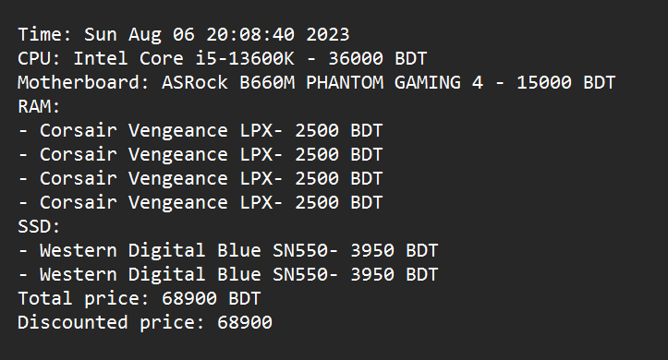
void generateLog(PCConfig config) {
time_t now = time(0);
char *dt = ctime(&now);
std::ofstream logFile("Private/purchase_log.txt", std::ios::app);
if (!logFile) {
std::cerr << "Error creating the log file.\n";
return;
}
logFile << "Time: " << dt;
logFile << "CPU: " << config.selectedCPU.getName() << " - " << config.selectedCPU.getPrice() << " BDT" << std::endl;
logFile << "Motherboard: " << config.selectedMotherboard.getName() << " - " << config.selectedMotherboard.getPrice() << " BDT" << std::endl;
logFile << "RAM:" << std::endl;
for (i = 0; i < config.numRAMs; ++i) {
logFile << "- " << config.selectedRAM[i].getName() << "- " << config.selectedRAM[i].getPrice() << " BDT" << std::endl;
}
logFile << "SSD:" << std::endl;
for (i = 0; i < config.numSSDs; ++i) {
logFile << "- " << config.selectedSSD[i].getName() << "- " << config.selectedSSD[i].getPrice() << " BDT" << std::endl;
}
logFile << "Total price: " << totalPrice << " BDT" << std::endl;
logFile << "Discounted price: " << calculateDiscountedPrice() << std::endl;
logFile << std::endl;
logFile.close();
}
purchase_log.txt

Slide 14
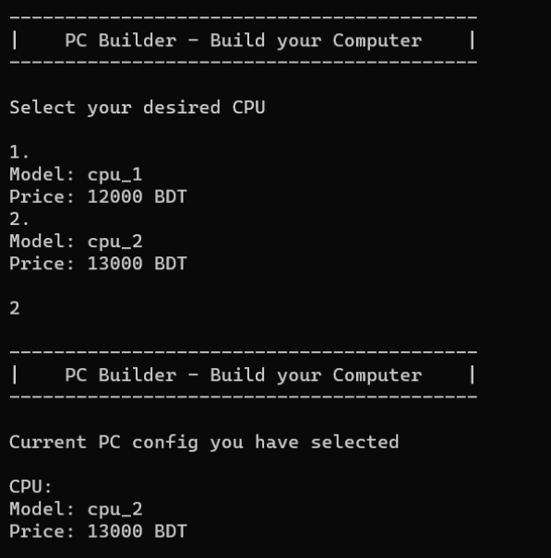
Code by Tanha Sayed Ahona
#include <iostream>
#include <iomanip>
#include <string>
#include <fstream>
#include <sstream>
class CPU;
class Motherboard;
class RAM;
class SSD;
class PCConfig;
void AddCPUFromDummyFile() {
cpuInRep = 0;
cpuRepository[cpuInRep].name = "cpu_1";
cpuRepository[cpuInRep].price = 12000.00;
cpuInRep++;
cpuRepository[cpuInRep].name = "cpu_2";
cpuRepository[cpuInRep].price = 13000.00;
cpuInRep++;
}
class CPU {
public:
CPU() {}
CPU(std::string name, double price) : name(name), price(price) {}
std::string getName() { return name; }
double getPrice() { return price; }
void showInfo() {
std::cout << "Model: " << name << "\n";
std::cout << "Price: " << price << " BDT\n";
}
friend void AddCPUFromDummyFile();
private:
std::string name, socketType;
double price;
};

Slide 15
void ShowHomePage() {
std::cout << std::endl;
std::cout << "------------------------------------------\n";
std::cout << "| PC Builder - Build your Computer |\n";
std::cout << "------------------------------------------" << std::endl;
std::cout << std::endl;
std::cout << "Current PC config you have selected" << std::endl;
std::cout << std::endl;
customerConfig.showInfo();
std::cout << std::endl;
std::cout << "Select your components (Chronologically recommended)" << std::endl;
std::cout << std::endl;
std::cout << "Core components:" << std::endl;
std::cout << "1. CPU" << std::endl;
std::cout << "2. Motherboard" << std::endl;
std::cout << "3. Ram" << std::endl;
std::cout << "4. SSD" << std::endl;
std::cout << "Enter 5 to checkout!!";
std::cout << std::endl;
std::cout << std::endl;
while (true) {
std::cout << "Input: ";
int userInput;
std::cin >> userInput;
switch (userInput) {
case 1:
ShowCpuPage();
return;
case 2:
ShowMotherboardPage();
return;
case 3:
ShowRamPage();
return;
case 4:
ShowSsdPage();
return;
case 5:
CheckOut();
return;
default:
std::cout << "Invalid response! Input again: \n";
}
}
}
void CheckOut() {
std::cout << "Congrats!!!!" << std::endl;
std::cout << "Current PC config you have selected" << std::endl;
std::cout << std::endl;
customerConfig.showInfo();
std::cout << std::endl;
std::cout << "Total price:: " << CalculateTotalCost(customerConfig) << std::endl;
std::cout << std::endl;
std::cout << "BYE BYE!!";
}

Slide 16
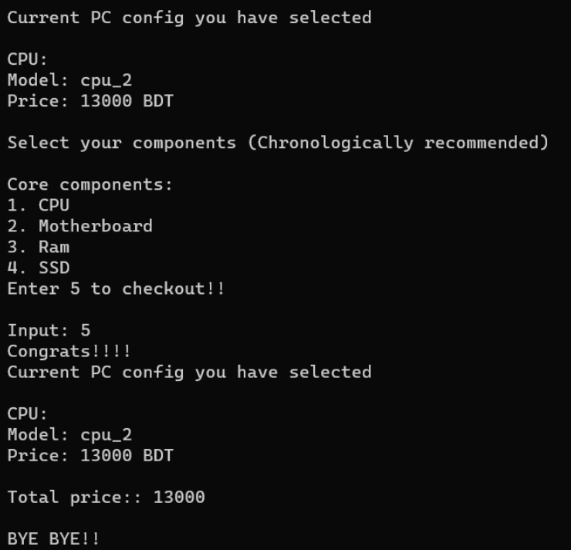
class PCConfig {
public:
void addCPU(CPU& cpu) {
cpuIsSelected = true;
selectedCPU = cpu;
}
void addRAM(RAM& ram, int quantity) {
for (int i = 0; i < quantity; i++) {
selectedRAM[numRAMs] = ram;
numRAMs++;
}
}
void showInfo() {
if (cpuIsSelected == true) {
std::cout << "CPU: \n";
selectedCPU.showInfo();
}
if (motherboardIsSelected == true) {
std::cout << "Motherboard: \n";
selectedMotherboard.showInfo();
}
if (numRAMs > 0) {
std::cout << "RAM: \n";
for (int i = 0; i < numRAMs; ++i) {
selectedRAM[i].showInfo();
}
}
if (numSSDs > 0) {
std::cout << "SSD: \n";
for (int i = 0; i < numSSDs; ++i) {
selectedSSD[i].showInfo();
}
}
}
friend double CalculateTotalCost(PCConfig&);
double CalculateTotalCost(PCConfig& config) {
double totalCost = 0.0;
totalCost = config.selectedCPU.getPrice() + config.selectedMotherboard.getPrice();
for (int i = 0; i < config.numRAMs; ++i) {
totalCost += config.selectedRAM[i].getPrice();
}
for (int i = 0; i < config.numSSDs; ++i) {
totalCost += config.selectedSSD[i].getPrice();
}
return totalCost;
}

Slide 17
“ THANKS FOR WATCHING
OUR PRESENTATION ”
Sumaiya Akter - 2107080
Presented By : Md. Enam E Elahi -2107012
Tanha Sayed Ahona - 2107095

